Slide 1
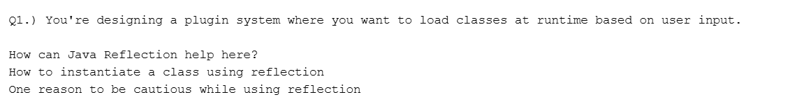
Name : CHAVAN ADVAIT GURUNATH
Email id : advaitchavan135@gmail.com
1. How Java Reflection Can Help with a Plugin System
Java Reflection enables you to inspect classes, methods, and fields at runtime without having compile-time visibility of them. In a plugin system, you can let users (or configuration files) specify a class name. Using reflection, your application can:
Dynamically load classes: Instead of hardcoding which classes to use, you can decide at runtime which plugin class to load.
Inspect class details: Once a class is loaded, you can analyze its methods and fields to determine if it meets the required interface or functionality.
Call methods dynamically: The plugin’s methods can be invoked without static bindings, allowing flexible integration of new features.
This dynamic behavior makes system extensible, allowing new plugins to be added without recompiling your whole application.
2. Instantiating a Class with Reflection
To create an instance of a class using Java Reflection :
Load the Class: Use Class.forName("fully.qualified.ClassName") to obtain the Class object.
Get the Constructor: Retrieve the desired constructor using methods like getDeclaredConstructor().
Create an Instance: Call newInstance() on the constructor.
3. A Reason to Be Cautious with Reflection
While reflection is powerful, it comes with drawbacks:
Breaking Encapsulation and Type Safety: Reflection allows you to bypass normal access controls, which can lead to unintended side effects if private fields or methods are altered or accessed. This can make your code more fragile and harder to maintain.
Performance Overhead: Since reflective operations are inherently slower than direct code execution, they can introduce performance penalties if used excessively.
Potential Security Issues: Granting runtime access to features can expose vulnerabilities, especially if user input isn’t properly validated.
Due to these factors, it’s critical to use reflection judiciously and only in cases where its benefits outweigh the drawbacks.

Slide 2
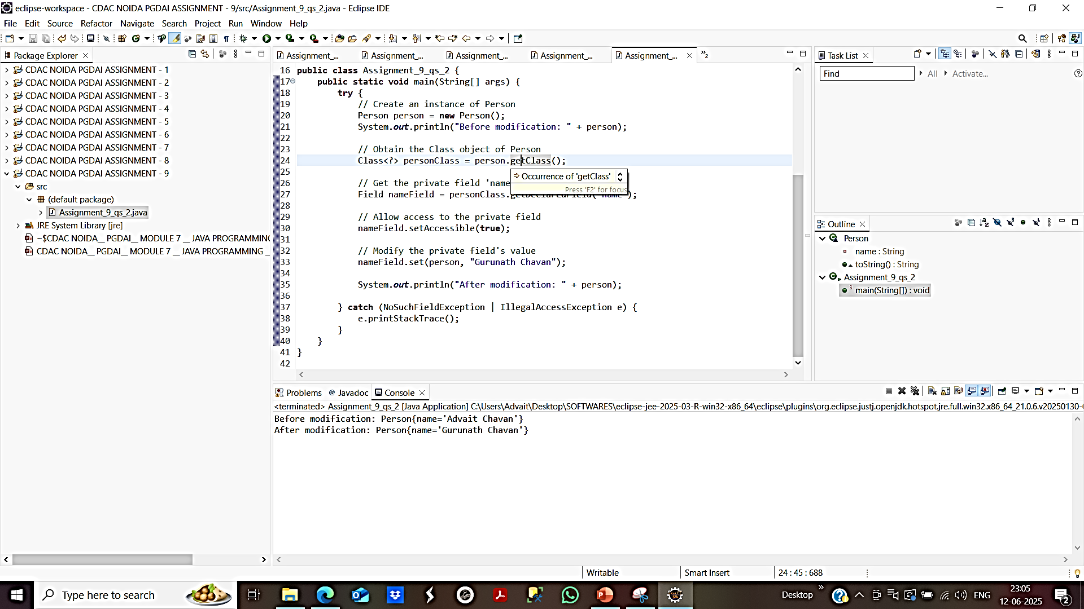
Name : CHAVAN ADVAIT GURUNATH
Email id : advaitchavan135@gmail.com
Obtain the Class Object: Use the object’s class (or Class.forName("...") if you only have the class name) to get its Class object.
Get the Field: Retrieve the private field using the getDeclaredField("fieldName") method on the Class object.
Bypass Access Checks: Call setAccessible(true) on the Field object. This overrides Java’s access control checks, allowing you to access even private fields.
Read or Modify the Field: Use field.get(object) to read the value and field.set(object, newValue) to modify the field’s value.

Slide 3
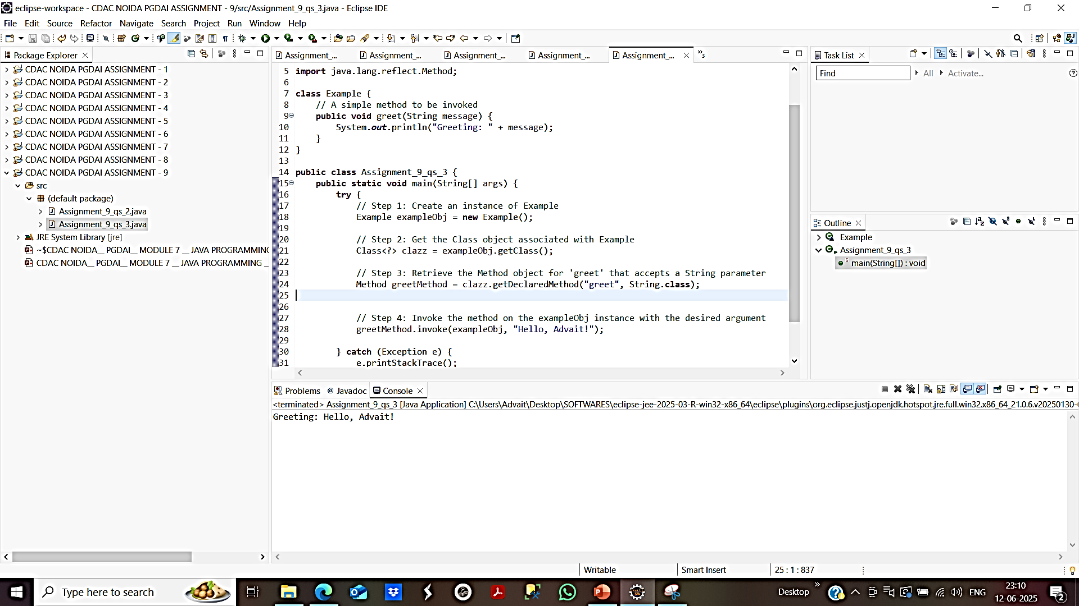
Name : CHAVAN ADVAIT GURUNATH
Email id : advaitchavan135@gmail.com
Steps to Invoke a Method with Reflection
Obtain the Class Object: Use an instance’s getClass() method or Class.forName("fully.qualified.ClassName") if you have the class name.
Retrieve the Method Object: Use the getDeclaredMethod("methodName", parameterTypes...) (or getMethod for public methods) to get a Method object corresponding to the method you want to invoke.
Set Accessible if Needed: If the method is not public, call setAccessible(true) on the Method object to bypass Java’s access checks.
Invoke the Method: Use the invoke(Object instance, Object... args) method on the Method object. The first argument is the instance on which to invoke the method (use null for static methods), followed by any parameters the method requires.

Slide 4
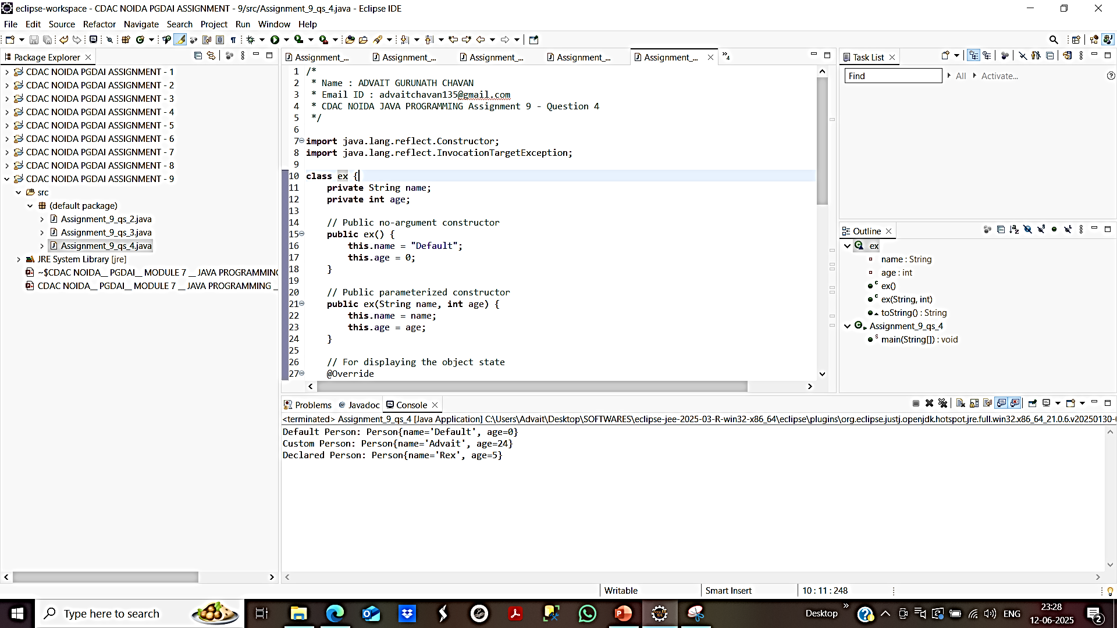
Name : CHAVAN ADVAIT GURUNATH
Email id : advaitchavan135@gmail.com
Obtain the Class Object: This can be done using Class.forName("fully.qualified.ClassName") or by using the .class literal if the class is known at compile-time.
Retrieve the Constructor:
To get a public constructor, use getConstructor(parameterTypes...).
For any constructor (including private ones), use getDeclaredConstructor(parameterTypes...). If the constructor is non-public, call setAccessible(true) to override the access checks.
Instantiate an Object: Once the constructor is accessible, you invoke it using newInstance(...) with the appropriate parameters, which creates a new instance of the class.

Slide 5
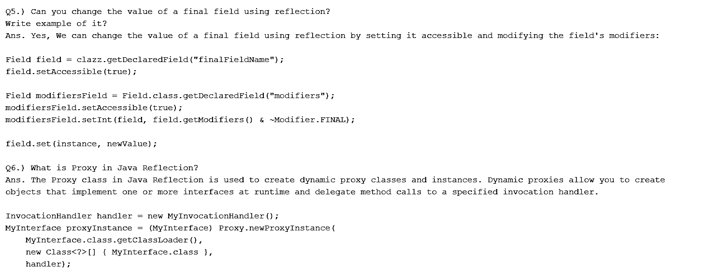
Name : CHAVAN ADVAIT GURUNATH
Email id : advaitchavan135@gmail.com

Slide 6
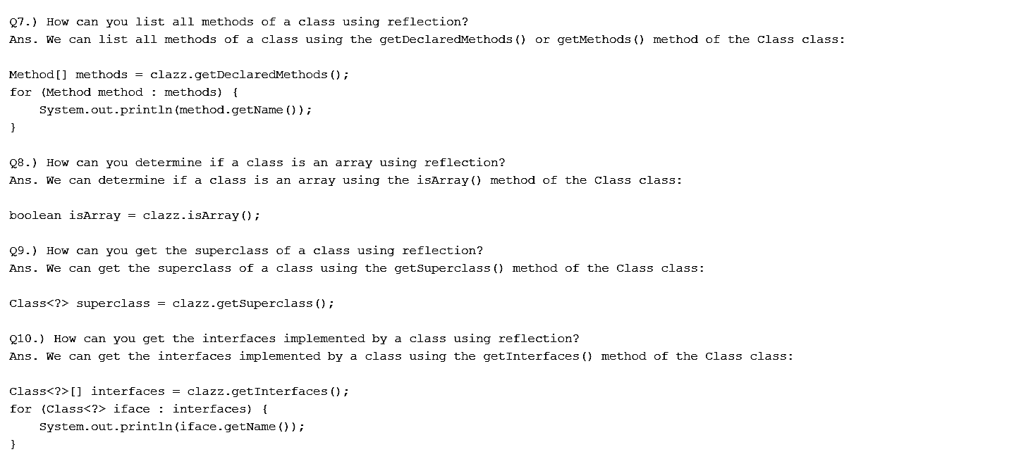
Name : CHAVAN ADVAIT GURUNATH
Email id : advaitchavan135@gmail.com

